Slide 1
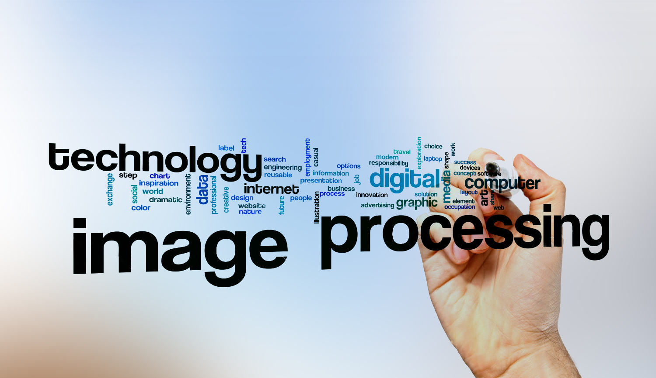

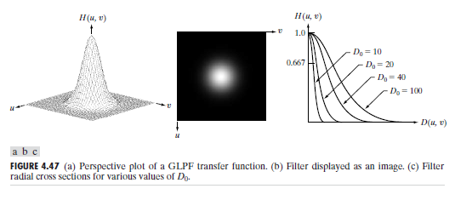
Digital Image Processing
27-Gaussian low pass filter
smoothing methods

Slide 2
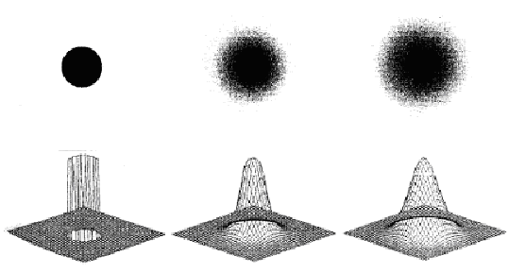
Digital Image Processing
27-Gaussian low pass filter
smoothing methods

